Slide 1
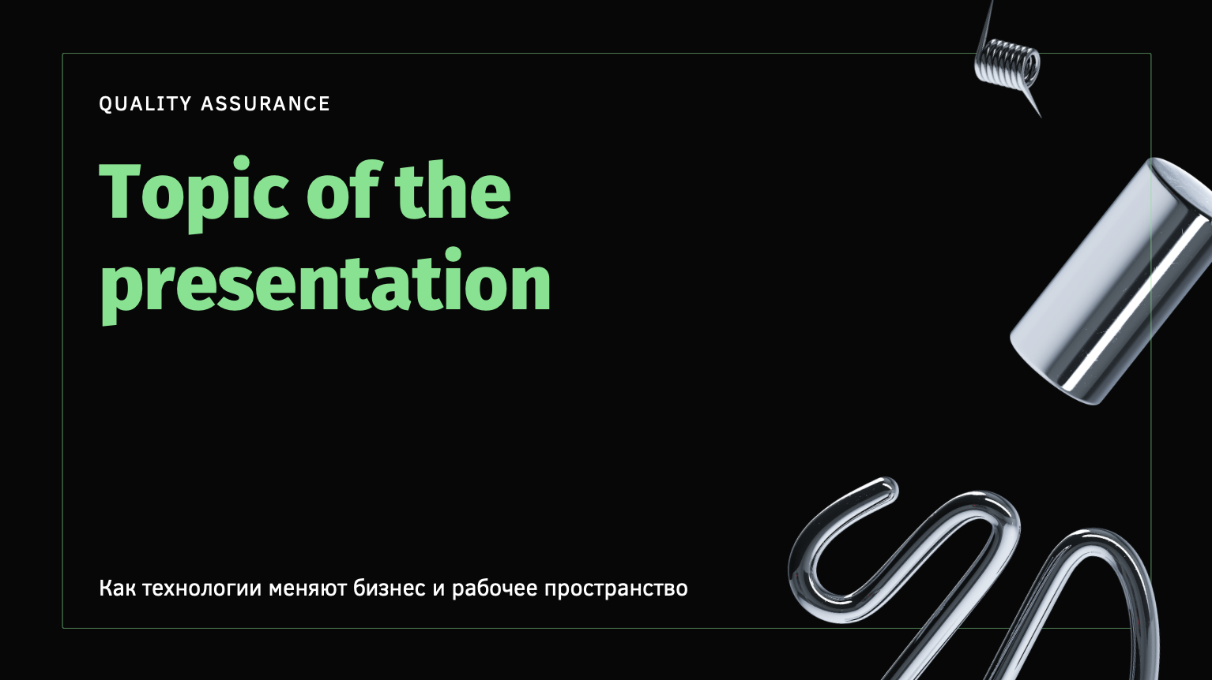
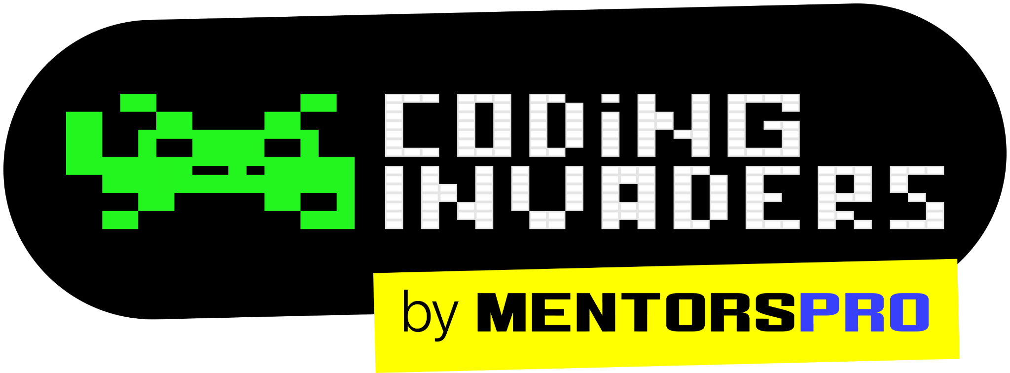
QA Automation Engineer
“Software Testing Introduction”
By: Manas
Content Title
Notes:
Title - Fira Sans, 50pt
Subtitle - Fira Sans, 16pt

Slide 2
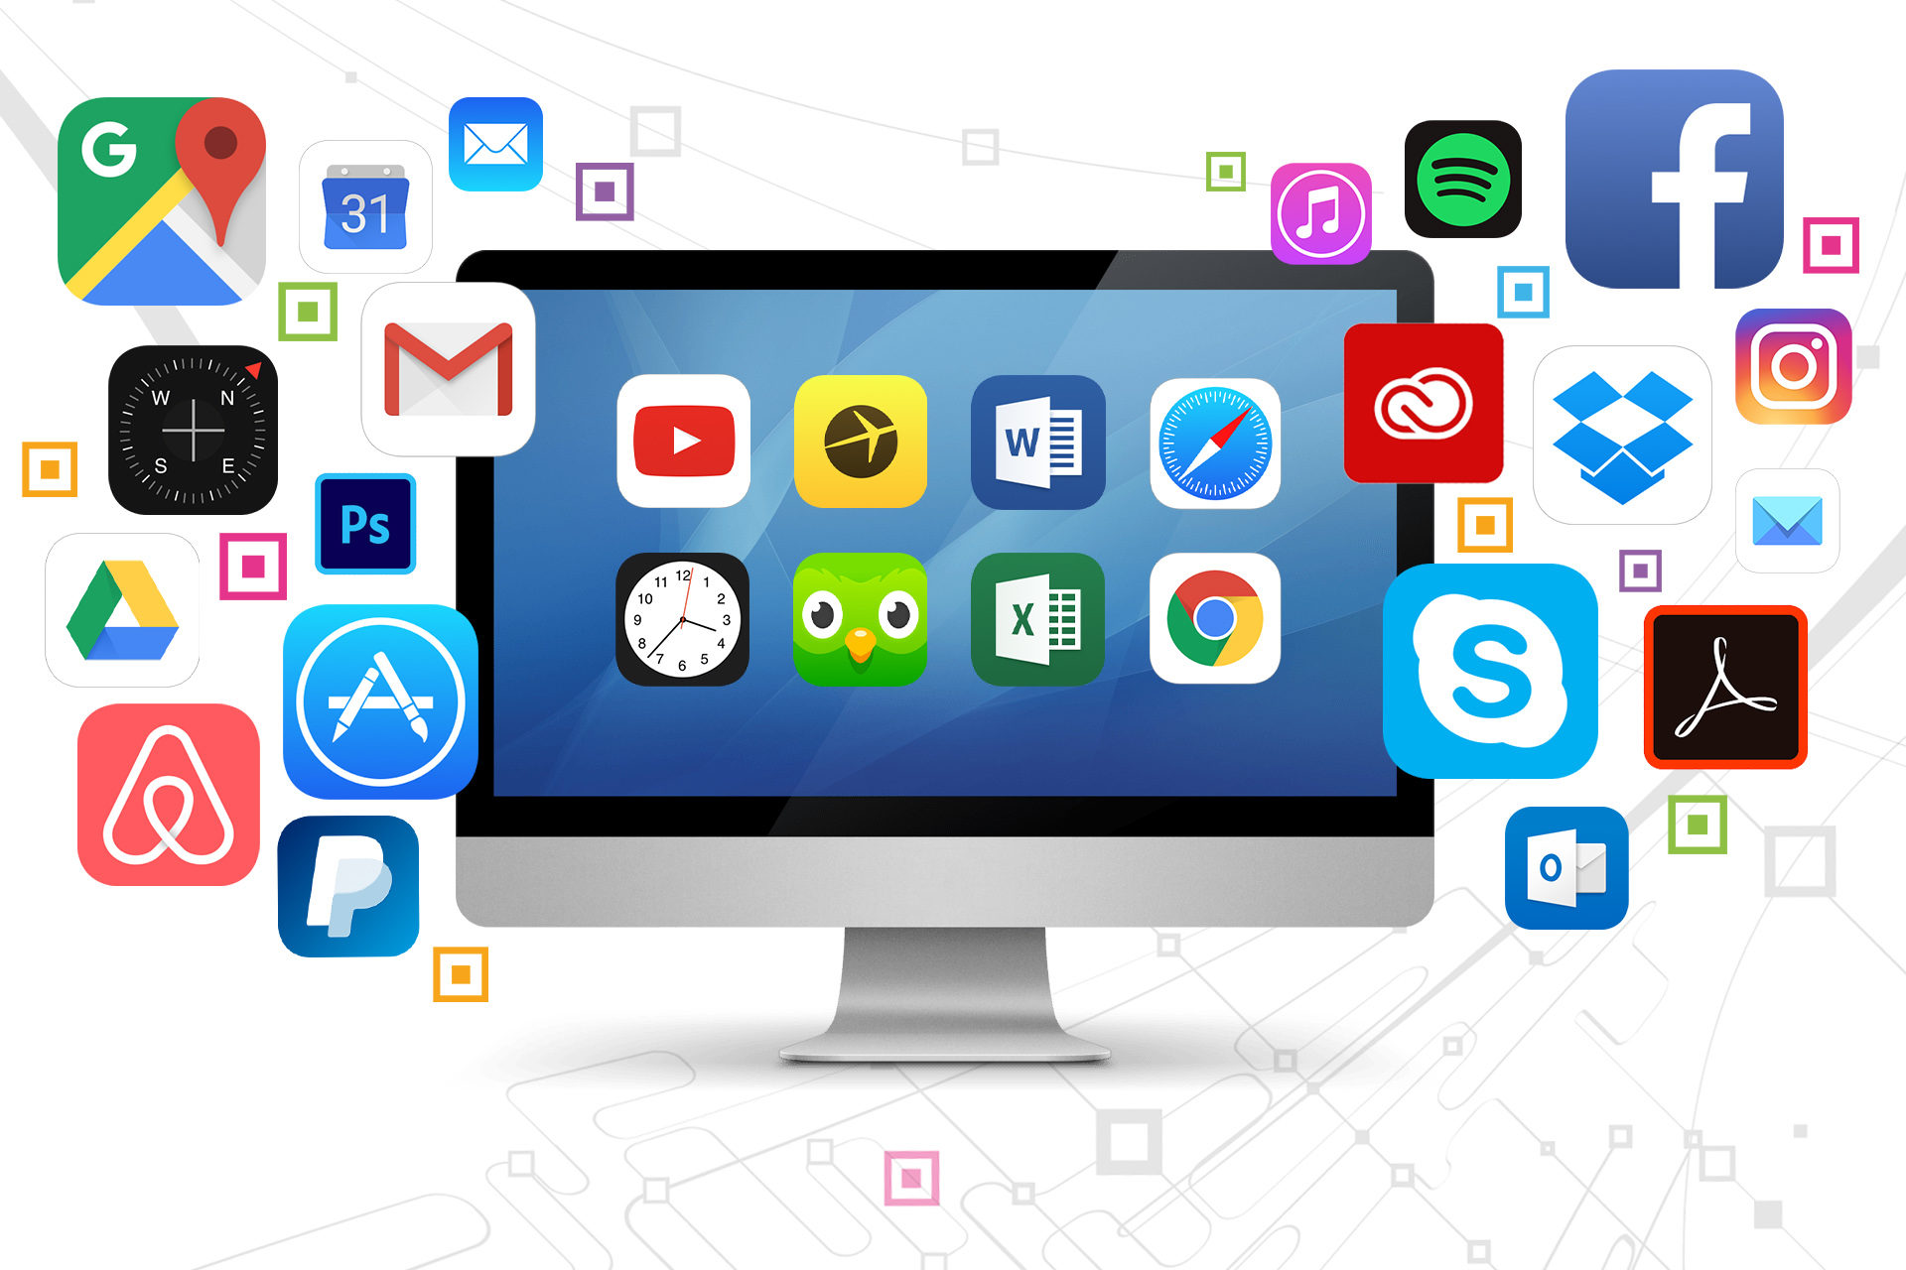
What is Software
A group of statement, set of logic and related data which gives instructions to systems what to do and how to do
As per usage software has been divided into 2 types:
Product Software
Project Software

Slide 3
Product Software: Product software is Developing software for segment of customer. (Group of customer) Project Software: Project software is Developing software for single Client.

Slide 4
As per the work there are two different types of companies available in industries
Service Based Companies
Product Based Companies
Note: product-based companies (which develop their own software for multiple users) and service-based companies (which focus on individual projects for clients)

Slide 5
Product Based Company: A company which is focusing on developing their own software is called product based company.
Ex. Microsoft, Amazon, Google
Service Based Company: A company which is mainly focusing on individual project for individual client is called Service based company.
Ex. Accenture, Wipro, Infosys, TCS

Slide 6
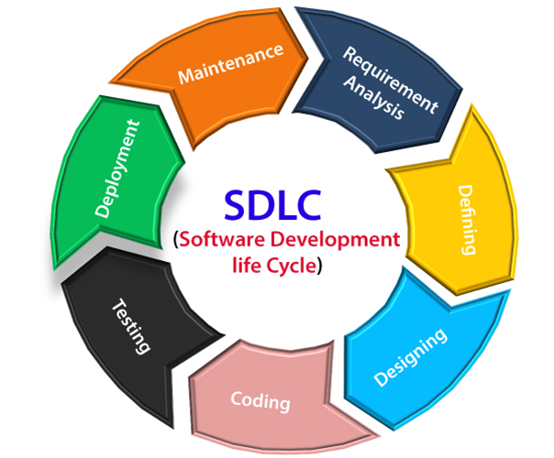
Software Development Life Cycle (SDLC)
SDLC is the step-by-step process which we are following to complete the software project that includes both Development and Testing.
Different phases in SDLC:
Requirement
Analysis
Design
Coding
Testing
Deployment
Release and Maintenance

Slide 7
Software Testing
Preforming testing on the software application or product as per the client requirements is called Software Testing.
Software testing has been divided into two types
Manual Testing
Automation Testing

Slide 8
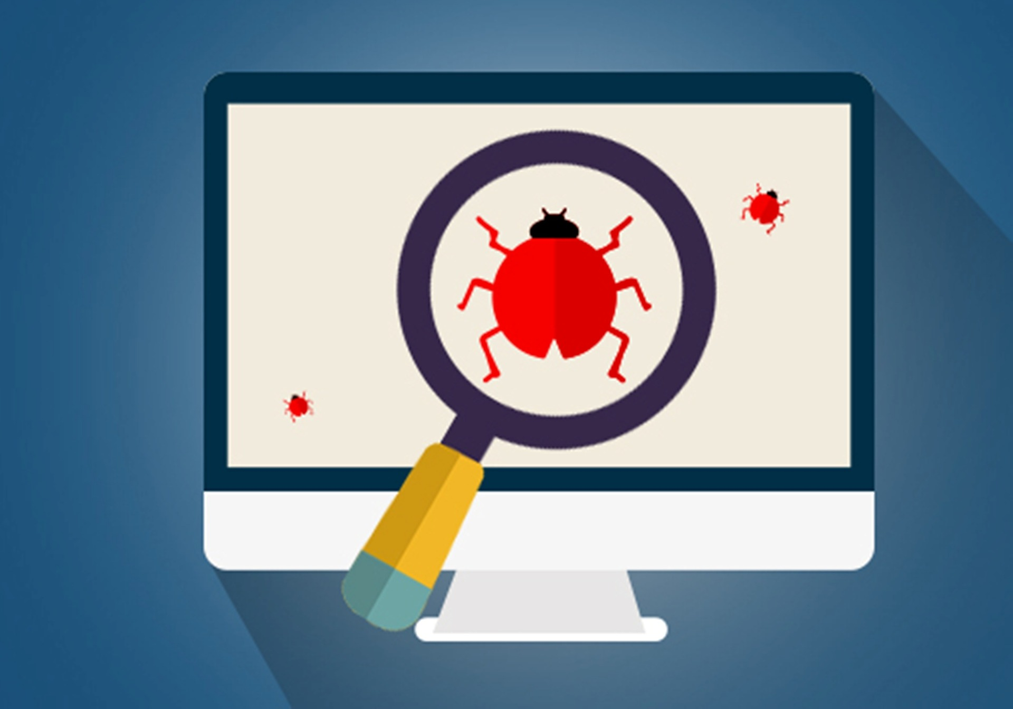
Manual Testing
Performing testing on software with human interaction is called Manual Testing.
Software manual testing is the process of evaluating and verifying that a software product or application does what it is supposed to do.

Slide 9
Levels of Testing
Smoke Testing
Sanity Testing
Installation Testing
Black box testing
White Box Testing
UAT Testing
Regression Testing
Performance Testing
Usability Testing

Slide 10
Smoke Testing
Smoke Testing confirms the basic functionality works for a product. Smoke Testing verify the stability of the build.
Validating the basic functionality of the application.
Sanity Testing
Sanity testing is detailed testing of each functionality to ensure that product/software runs without any logical error.

Slide 11
Points to Rember for Smoke Testing
Smoke Testing confirms the basic functionality works for a product. Smoke Testing verify the stability of the build.
Smoke Testing is a type of software testing, and it is performed to check that the new build is stable and further testing can be performed.
Smoke Testing perform before sanity testing.
Smoke Testing is performed every time when there is a new build.
The actual concept of smoke testing is to check whether there is any code crack or leakage in the new build.
Smoke Testing is also called Build Verification Testing

Slide 12
Points to Rember for Sanity Testing
Sanity testing is detailed testing of each functionality to ensure that product/software runs without any logical error.
Sanity Testing is a type of software testing, and it is performed at the end to check that the build is as expected, and all the flows are working correctly after bug fix or code changes.
Sanity Testing performed after Smoke Testing.
Sanity Testing is performed at the end or after the code changes or bug fix.
The actual concept of Sanity Testing is to check the build is working smoothly and as expected with new changes or after bug fixes.

Slide 13
Difference Between Sanity Testing and Smoke Testing
Sanity Testing | Smoke Testing
Sanity testing is detailed testing of each functionality to ensure that product/software runs without any logical error. | Smoke Testing confirms the basic functionality works for a product.
This testing is performed by the testers | Smoke testing is performed by the developers or testers
The objective of the testing is to verify the “functionality” of the system in order to proceed with more rigorous testing | The objective of this testing is to verify the “stability” of the system in order to proceed with more rigorous testing
Sanity Testing is like specialized health check up | Smoke testing is like General Health Check Up

Slide 14
Different Environment in Project
There are 4 different environment available in project:
Development Environment
QA/Testing Environment
UAT Environment
Production Environment

